Slide 1


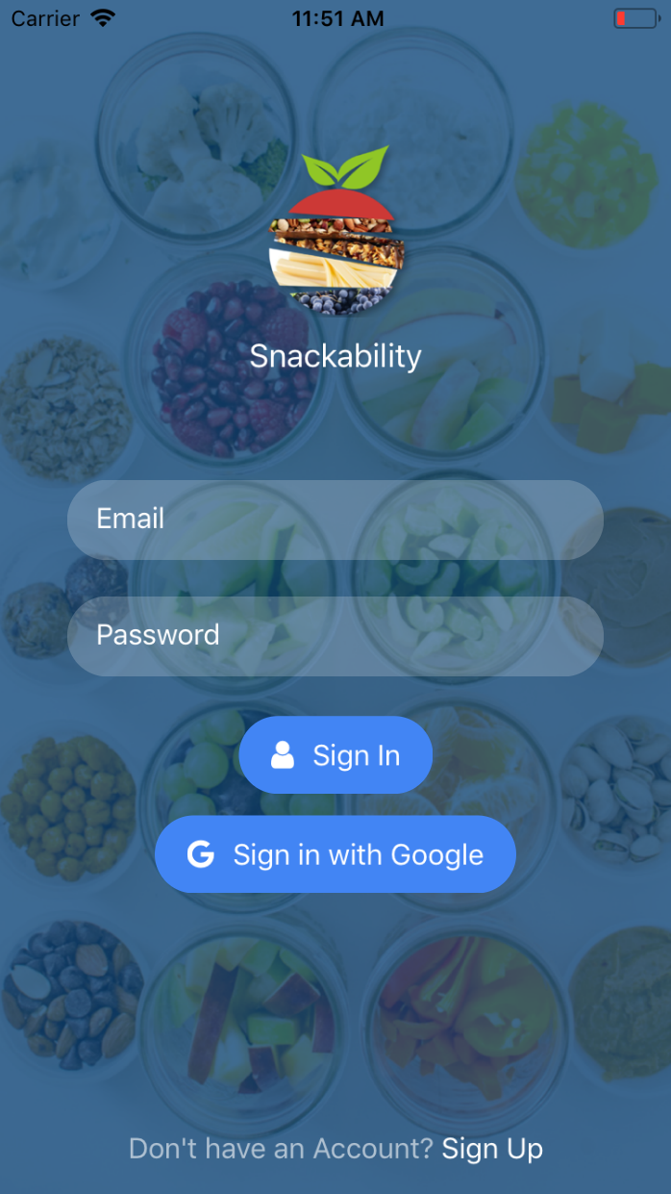
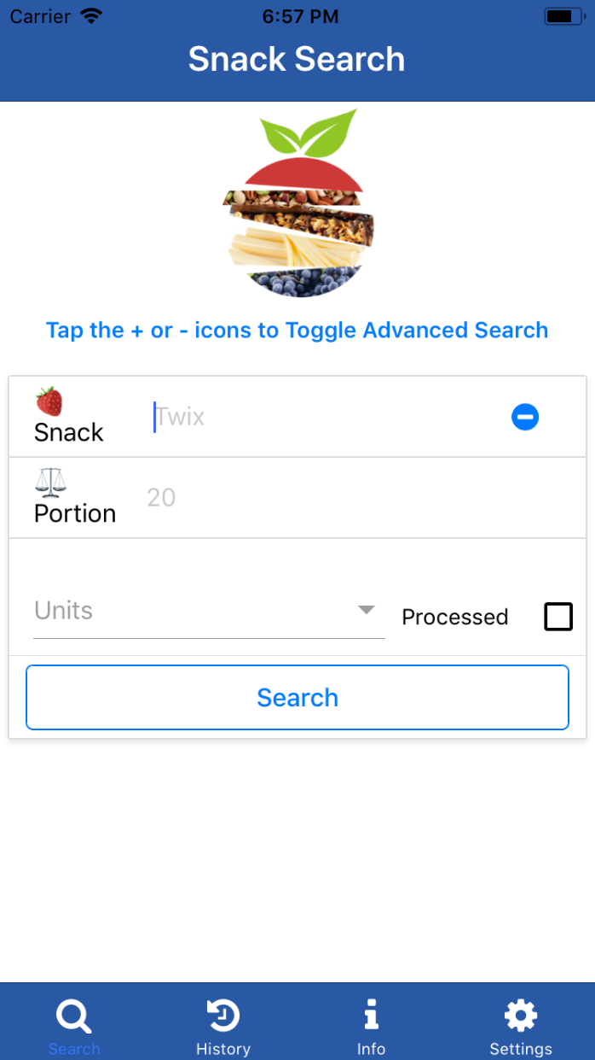
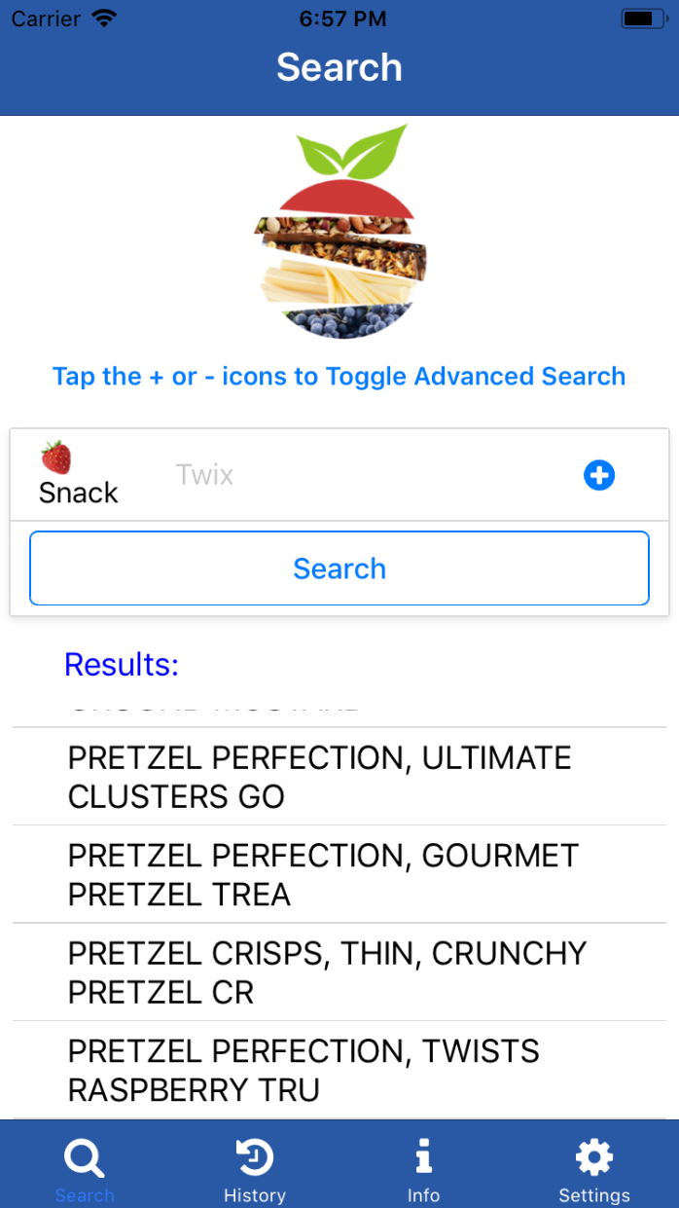
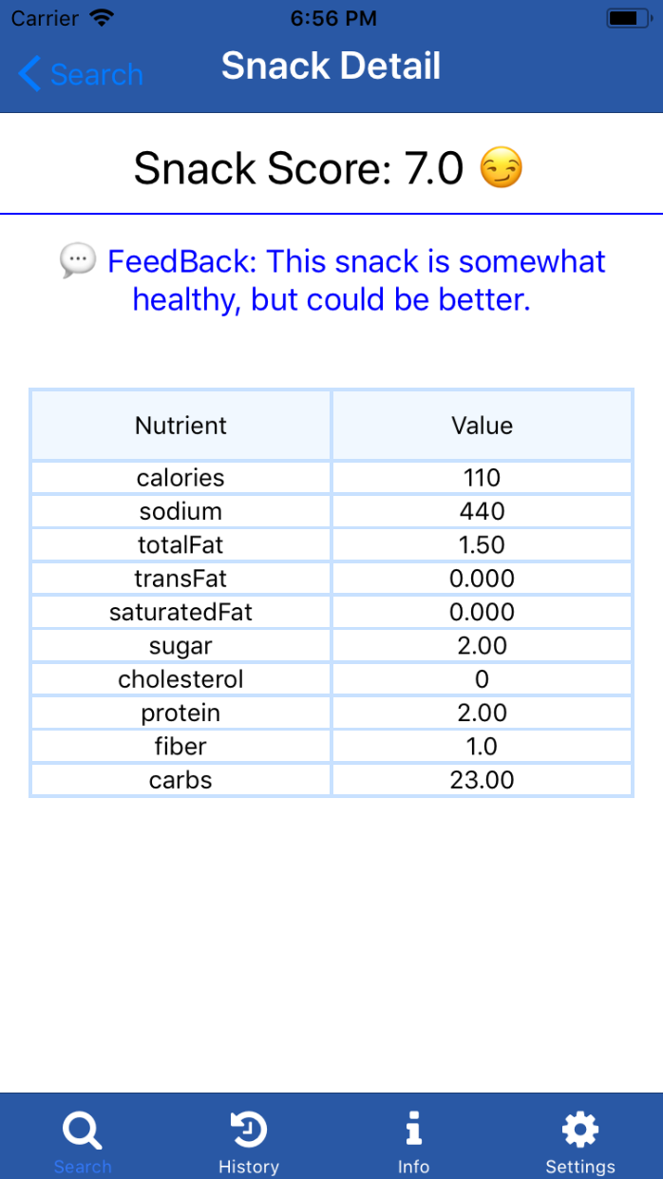
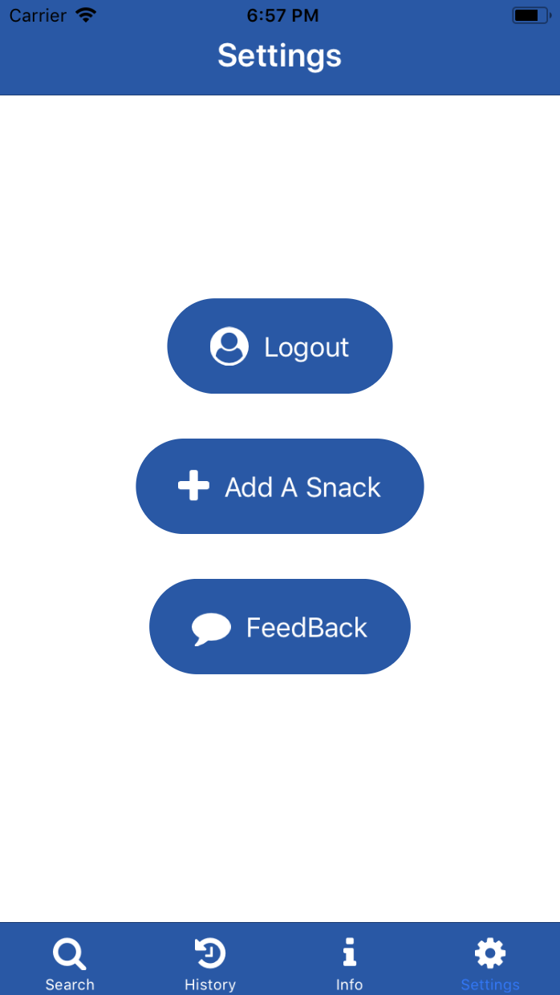
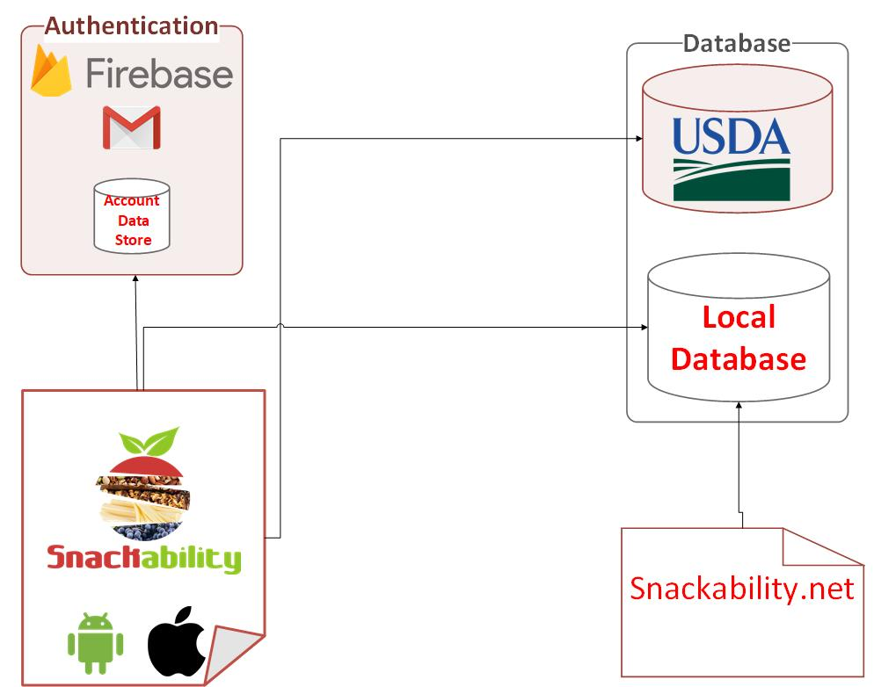
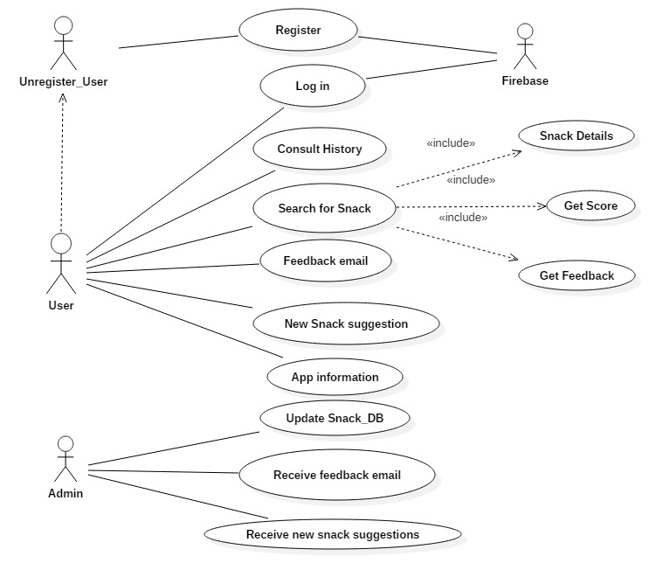
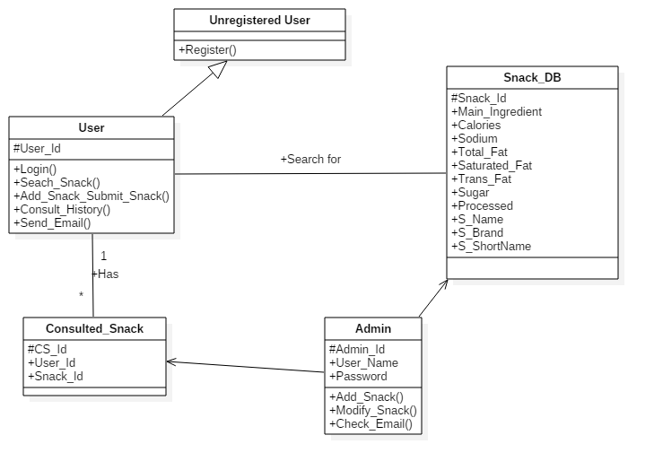
School of Computing & Information Sciences
Senior Project, 2018, Spring
Snackability 1.0
Student: Bertha M Perez, Florida International University
Mentor: Dr. Cristina Palacios, Department of Dietetics and Nutrition, Florida International University
Professor: Masoud Sadjadi, Florida International University
Problem
Snacks consumed by adolescent and college students are extremely unhealthy.
USDA guidelines for healthy snacking not being applied.
No apps available that specifically target snack and give a score
Solution
Dedicate mobile application that will use the USDA guidelines for healthy snack
User friendly app that would provide a score based on how healthy a snack is.
It will ask users to fill the name, size of the snack and if it is highly processed.
Current System
There are no available apps to specifically identify if a snack is healthy or not based on the USDA guidelines
Screenshots
Requirements
Support on iOS and Android devices.
Have the option to login using Gmail and local accounts.
Local database with snacks in FIU vending machines.
Access to the USDA database using an API.
Use USDA guidelines for healthy snacking to determine if a snack is healthy or not.
Provide a snack score.
Handle different food measurements.
Collect metrics.
System Design
Implementation
React Native to build the application for iOS and Android
Firebase for local and Google authentication and data persistence.
Redux used with React for complex state operation
API to access the USDA database.
MySQL Workbench for local database
Verification
Postman test was created to test various API endpoints.
Testing done on iOS and Android. Emulators and phone were used.
Manual testing to verify the different measurement conversion.
Manual testing to verify the Snack Score.
Object Design
Summary
The objective of this project was design an app that using the USDA guidelines provide a score based on how healthy a snack is.
This project is the first release of Snackability app.
The app is going to be tested during the summer, by the Nutrition Department at FIU.
Acknowledgement
The material presented in this poster is based upon the work supported by Dr. Cristina Palacios. I am thankful to the help that I received from my group member Frank Hernandez.
Notes:
‹#›

